Slide 1
Google Play Store App Trade Tracker
A Tableau Dashboard to Uncovering Key Insights for App Engagement and Success
(Capstone Project)
By
Babita Pruseth
Cohort Moscow, AlmaBetter
8th July 2024

Slide 2
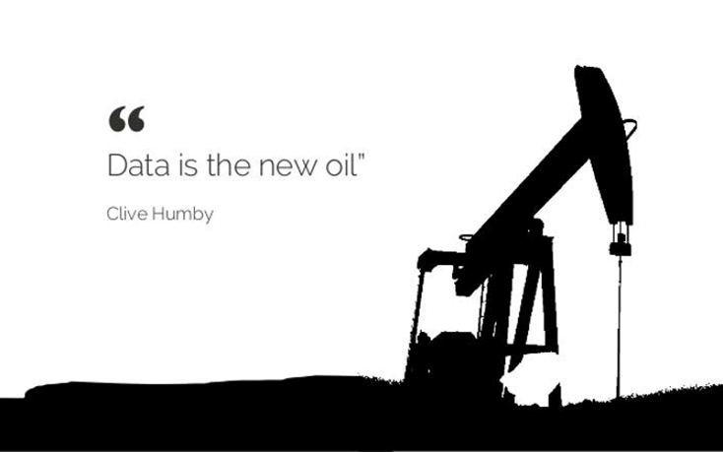
Introduction
The Google Play Store, formerly known as Android Market, serves as a significant digital distribution platform for various content types, including:
Apps
Books
Music
Movies
And more
As the Android ecosystem continues to expand rapidly, performing data analysis on this platform's data becomes crucial for extracting valuable insights that are beneficial for app development businesses.

Slide 3
Objective
To explore and analyze the Google Play Store dataset in a more visual and interactive way through a Tableau dashboard. The aim is to uncover the essential factors that influence app engagement and success.

Slide 4
Google Play Store Dataset Overview
Provide a brief description of the dataset, including:
Dataset link: Play Store Data.csv
Data sources and collection method: provided by AlmaBetter
Key fields (e.g., app name, category, rating, reviews, installs, etc.)
Number of records: 10840
Total APP count: 10346
Total App Categories: 33
Total Reviews: 4,20,39,29,191
Average Rating: 4.2
Total Installations; 146,630,337,417
Average App Size (Mb): 18.17

Slide 5
Methodology
Outline the steps taken in the analysis:
Data Cleaning: Through Exploratory Data Analysis for handling missing values, duplicates, and inconsistencies.
Data Transformation: Through Exploratory Data Analysis for Converting data types, creating new calculated fields.
Data Visualization: Using Tableau Desktop 2023.3 (https://www.tableau.com/support/releases) to create interactive dashboards for data exploration.

Slide 6
Tableau Dashboard Highlights
Showcase key features of this Tableau dashboard, such as:
Filter options (app, category, content rating, top N, top N (between 4 to 5 rating)
Interactive visualizations (bar charts, line plots, pie chart, heatmaps)

Slide 7
Key Insights
Highlight the findings from this analysis :
App Categories with the Most and Least Apps
Categories Receiving the Most Reviews
Categories Attracting the Most Installs
Categories with the Average Ratings
Variation of Required Android Versions Across Categories
Apps with the Highest Number of Installs
App size Analysis
Distribution of Different App Types on the Play Store
Variation of App Ratings with Different Android Versions
Apps with the Most Reviews
Most Expensive Apps
Apps with the Highest Ratings
Distribution of Content Ratings Across Apps
Impact of Content Ratings on the Number of Installs

Slide 8
Results and Analysis Insights from the Google Play Store Data

Slide 9
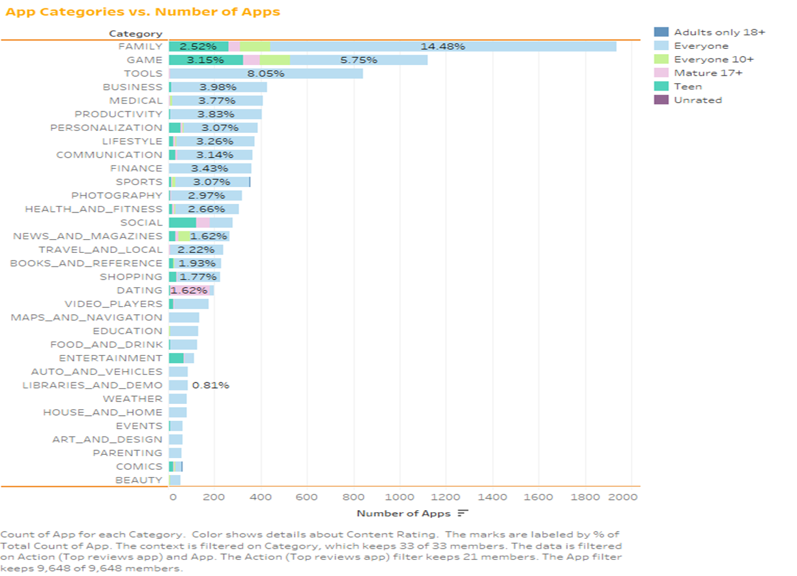
App Categories with the Most and Least Apps
"Mobile
is not
the future, it is the now. Meet your customers in the environment of their choice, not where it's convenient for you."
– Cyndie Shaffstall

Slide 10
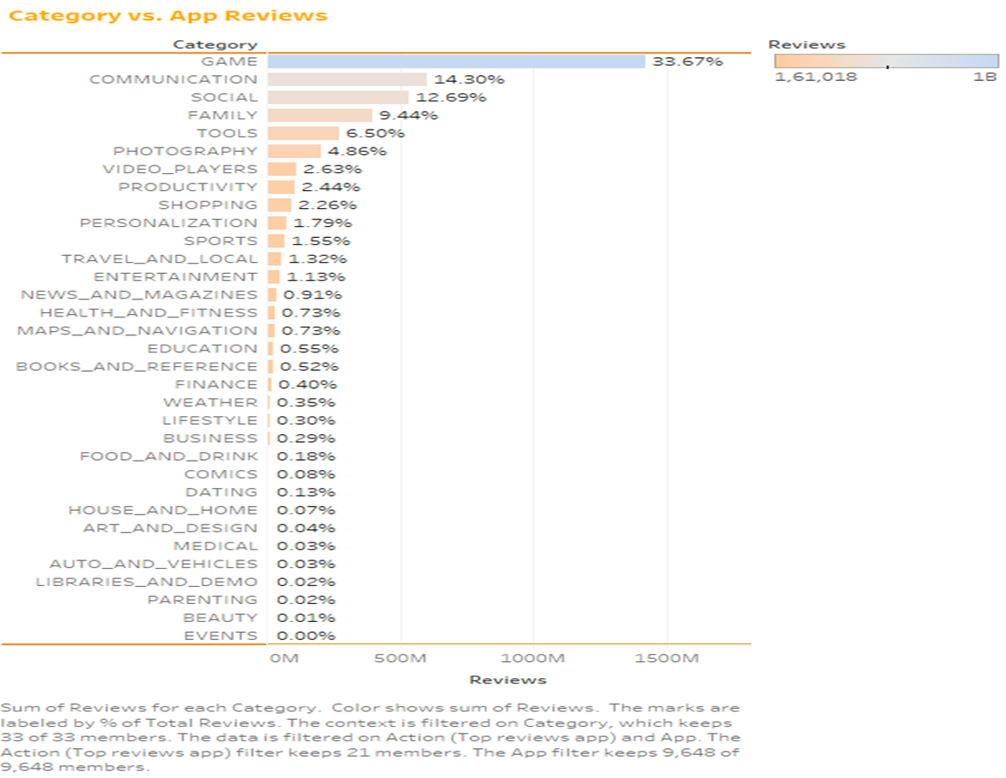
Categories Receiving the Most Reviews
"Your most unhappy customers are your greatest source of learning.“
– Bill Gates

Slide 11
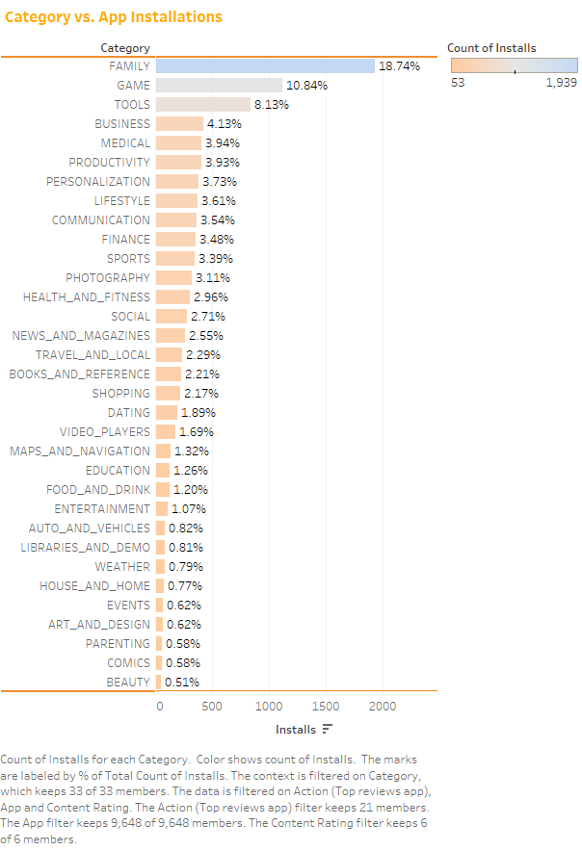
Categories Attracting the Most Installs
"The mobile phone acts as a cursor to connect the digital and physical."
– Marissa Mayer

Slide 12
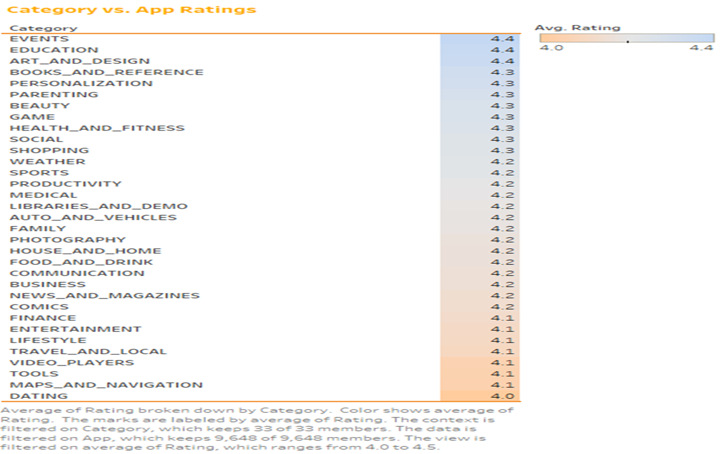
Categories with the Average Ratings
“The
Best
marketing tool you have is the customer."
– John Jantsch

Slide 13
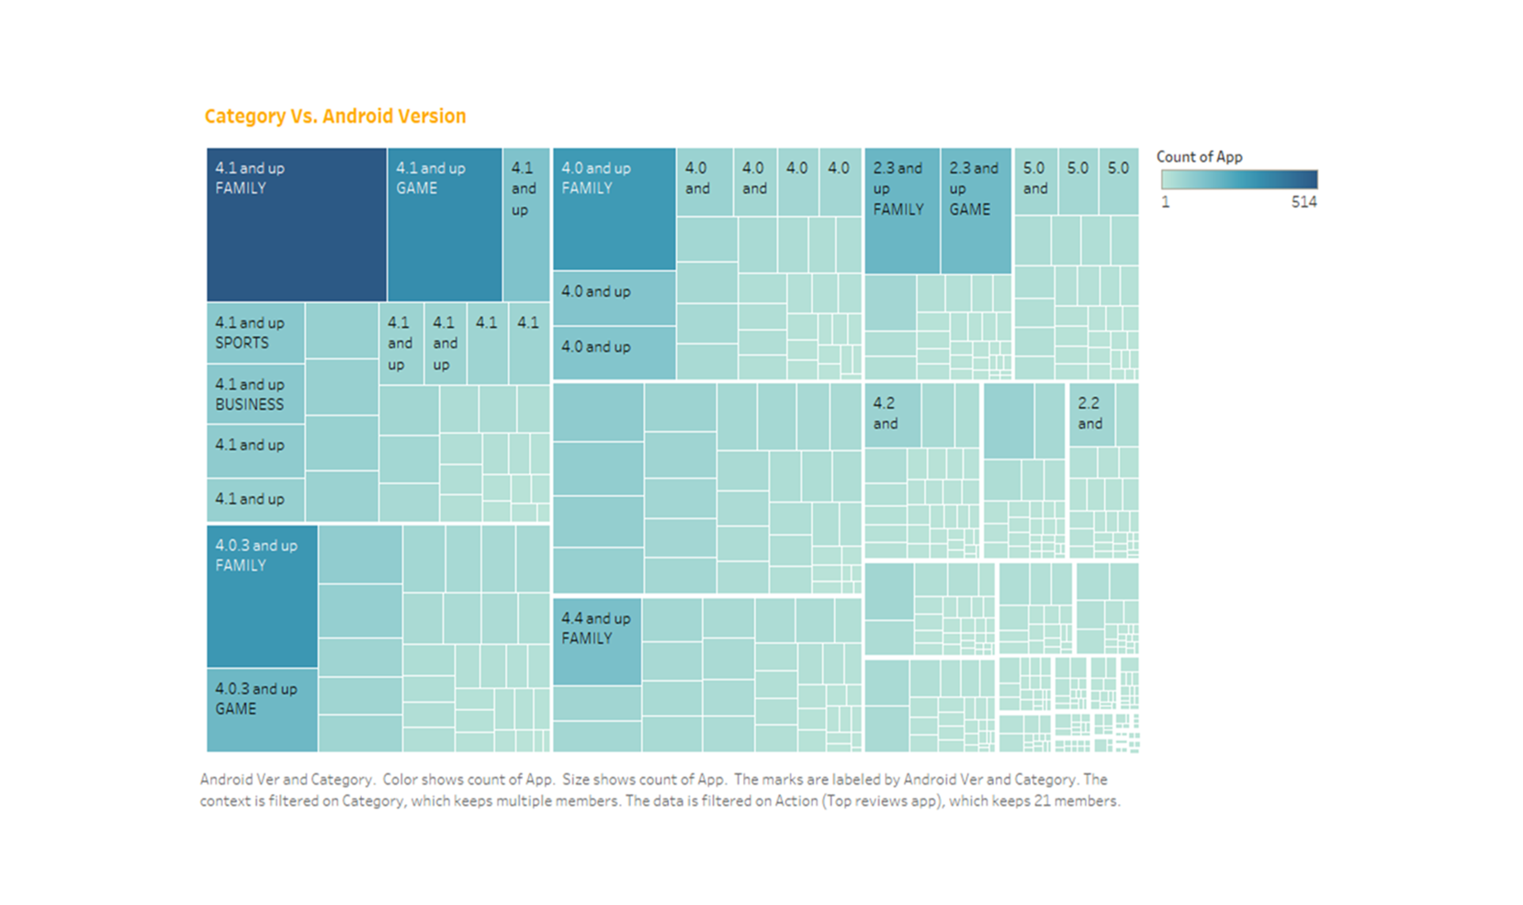
Variation of Required Android Versions Across Categories
"The
best way
to
predict the future is to invent it."
– Alan Kay

Slide 14
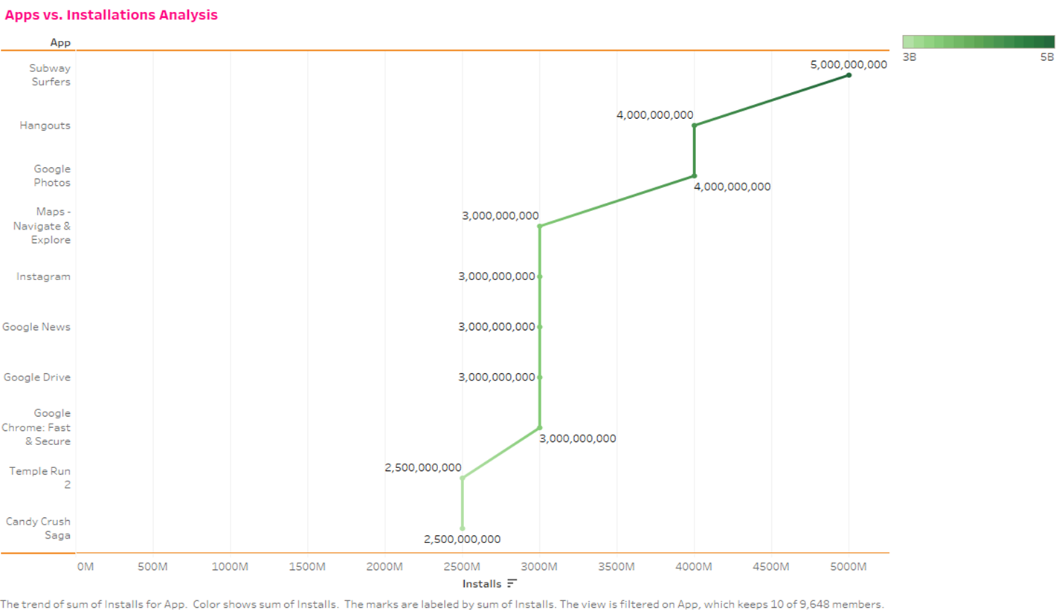
Apps with the Highest Number of Installs
"Numbers have an important story to tell. They rely on you to give them a clear and convincing voice.“
– Stephen Few

Slide 15
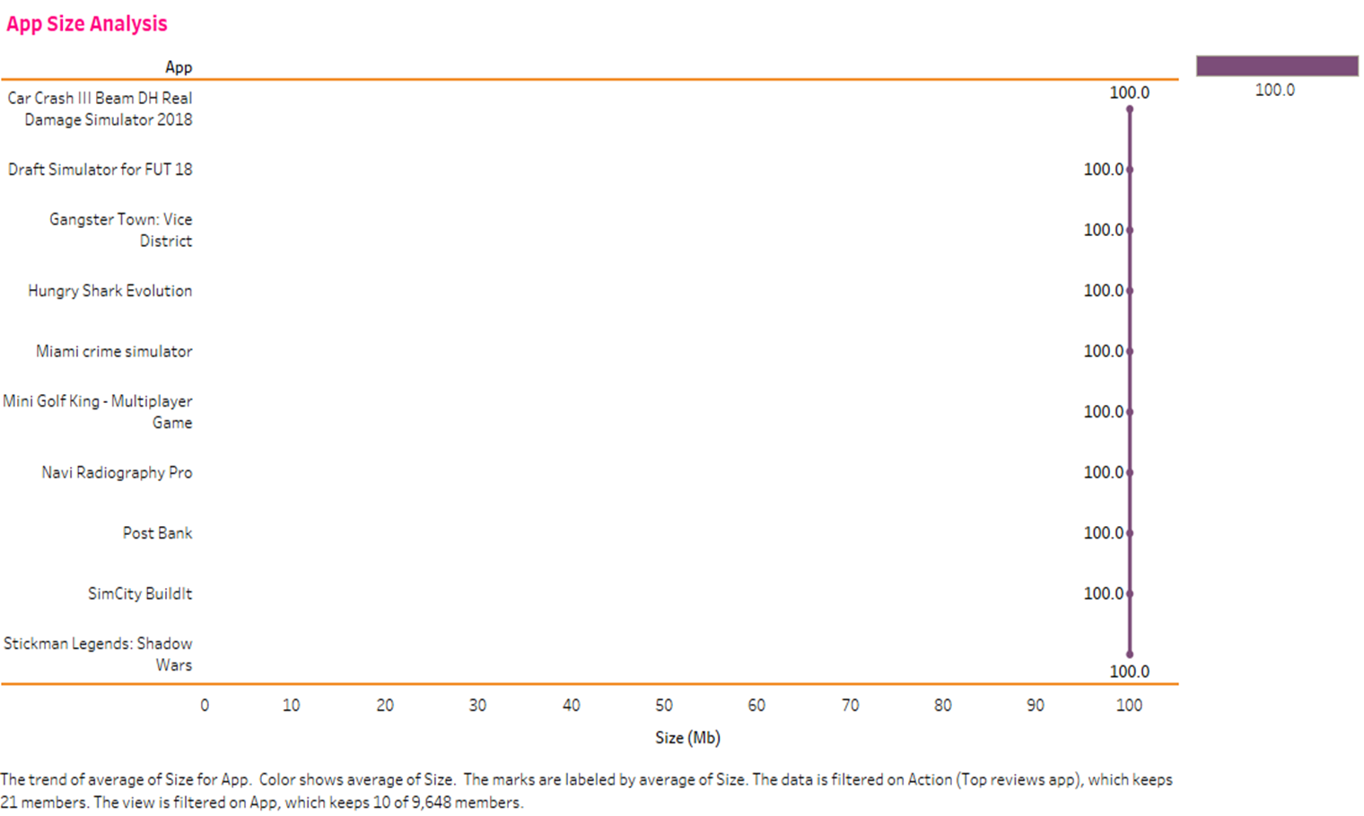
App size Analysis
"Data beats emotions."
– Sean Rad

Slide 16
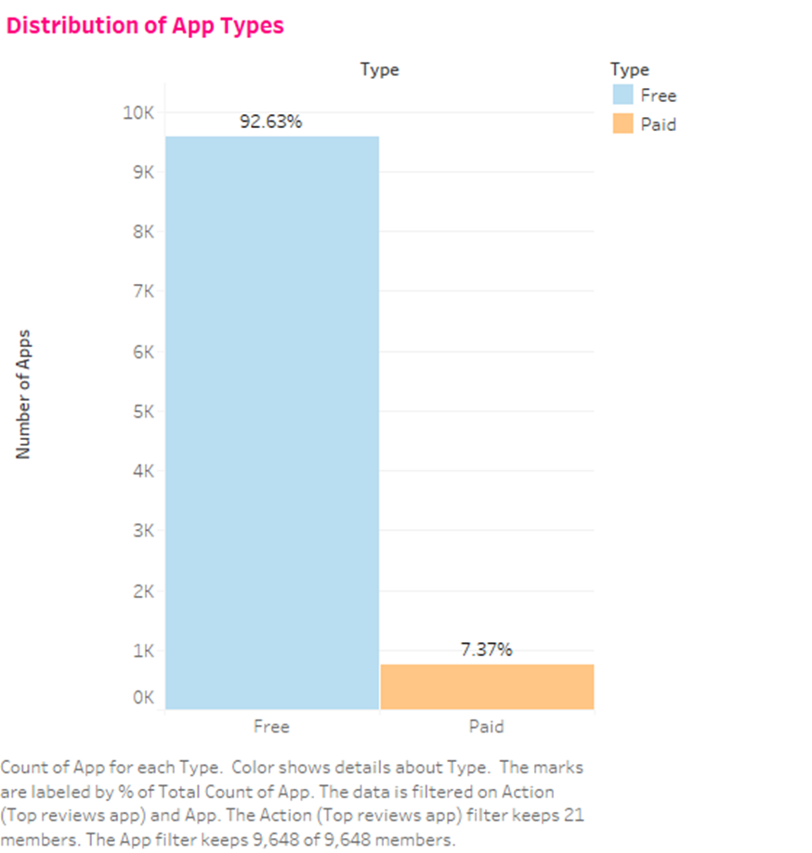
Distribution of Different App Types on the Play Store
"Big data is at the foundation of all the megatrends that are happening.“
– Chris Lynch

Slide 17
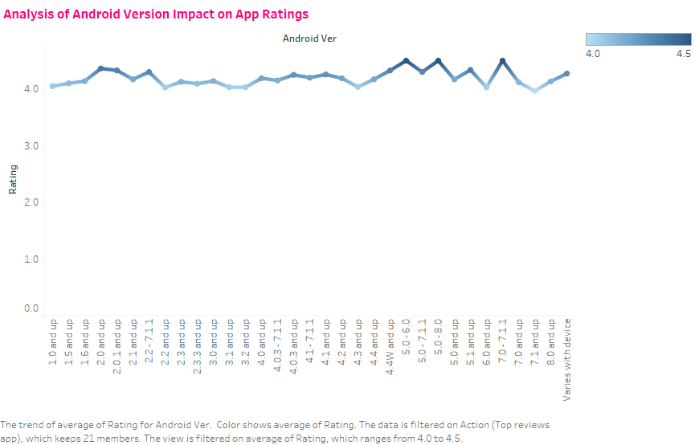
Variation of App Ratings with Different Android Versions
"Without data, you're just another person with an opinion."
– W. Edwards Deming

Slide 18
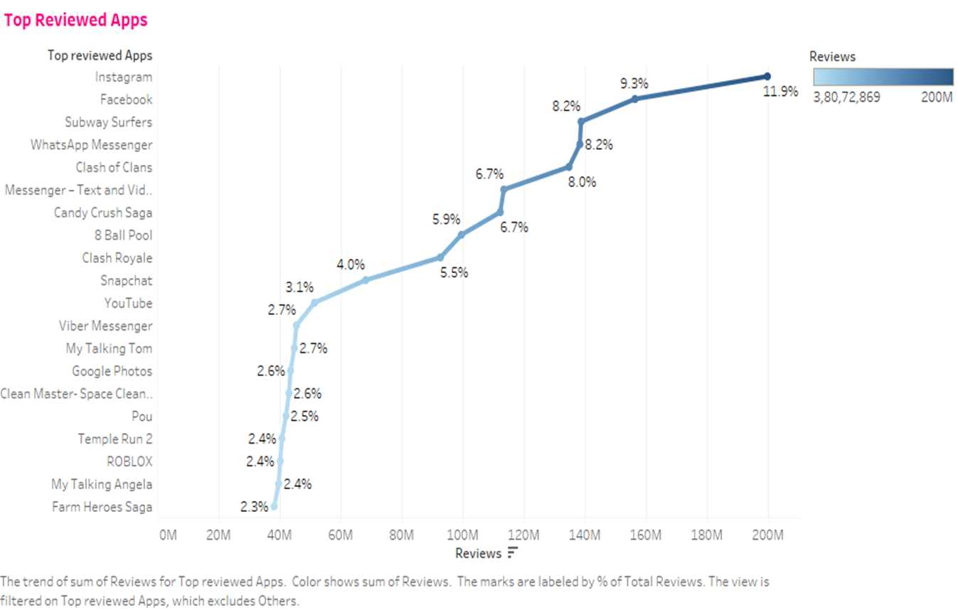
Apps with the Most Reviews
"The customer is always right."
– Harry Gordon Selfridge

Slide 19
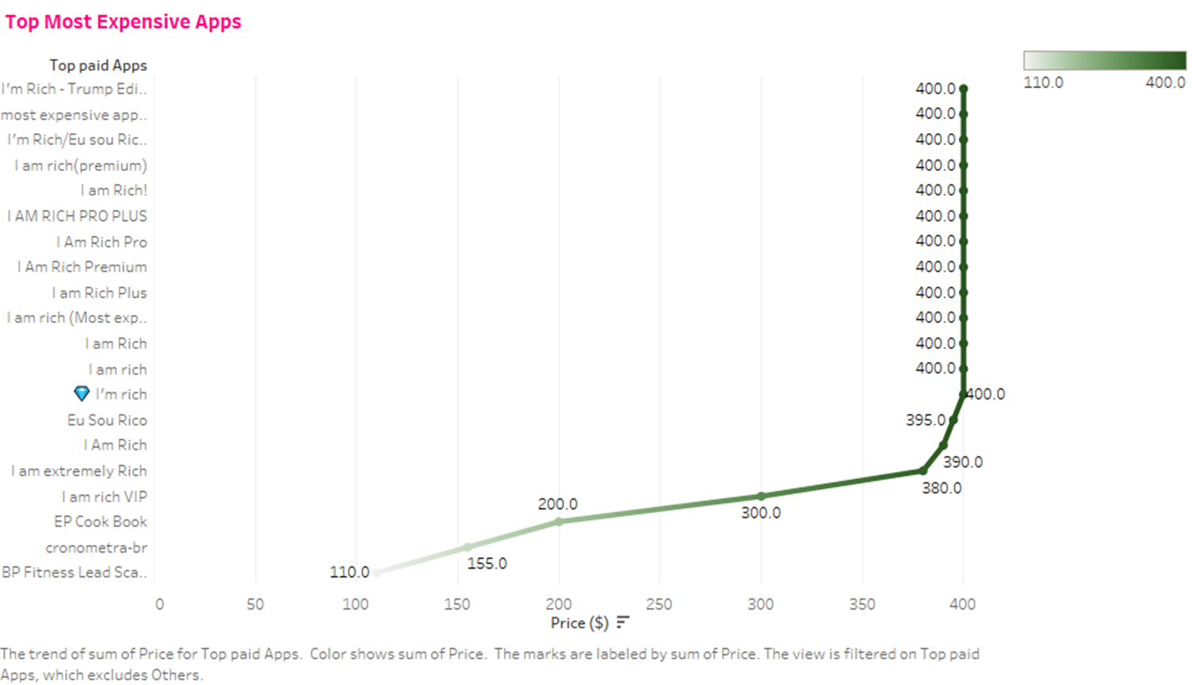
Most Expensive Apps
"The purpose of business is to create and keep a customer.“
– Peter Drucker

Slide 20
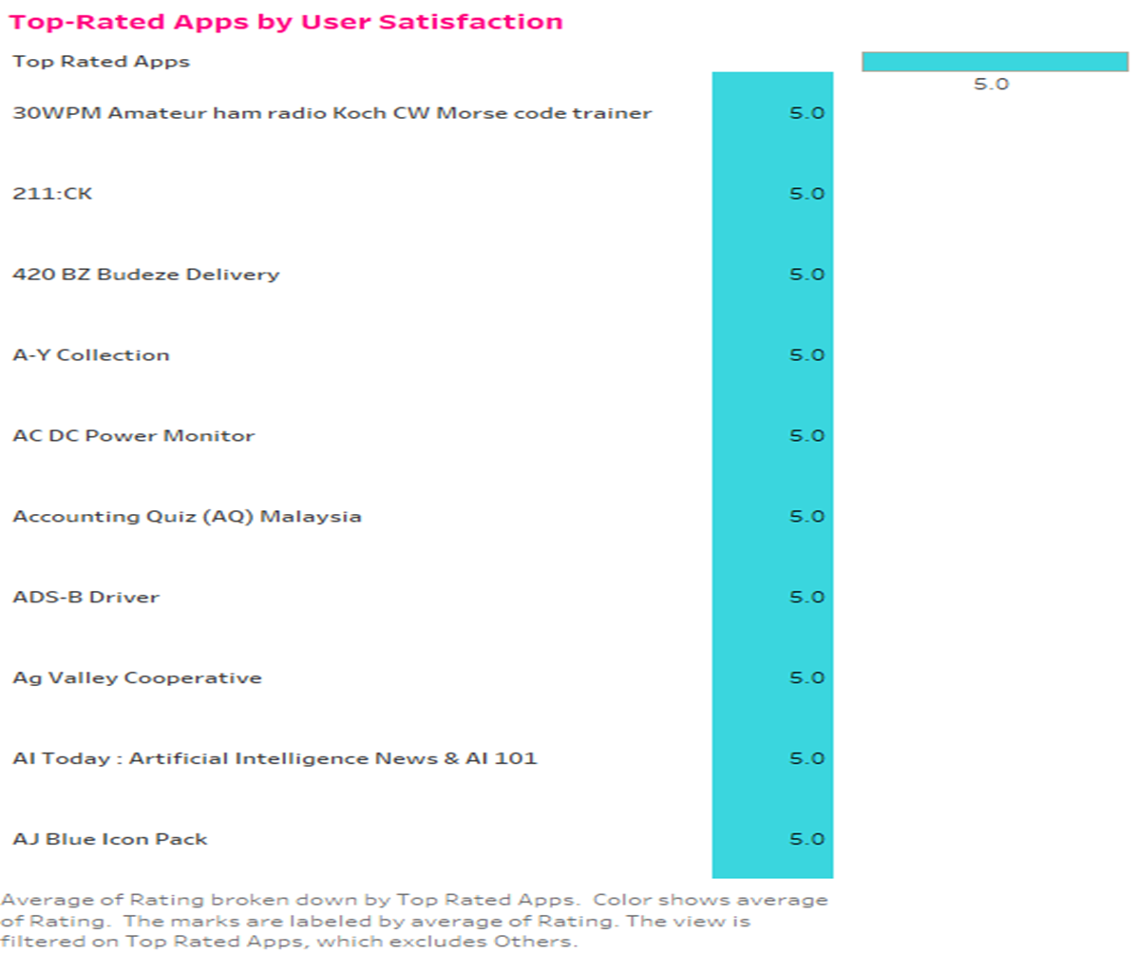
Apps with the Highest Ratings
"Quality is not an act, it is a habit."
– Aristotle

Slide 21
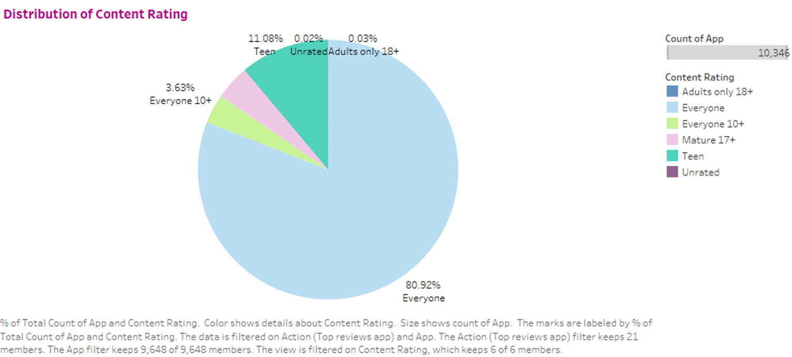
Distribution of Content Ratings Across Apps
"Content is
king."
– Bill Gates

Slide 22
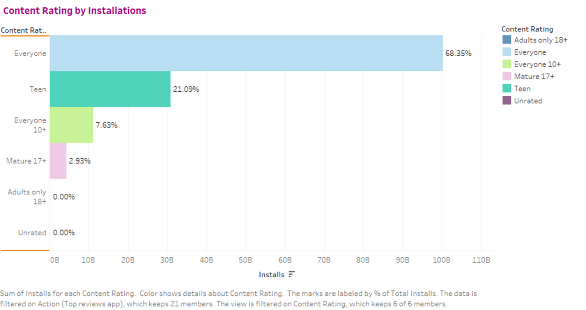
Impact of Content Ratings on the Number of Installs
"Content precedes design. Design in the absence of content is not design, it’s decoration.“
– Jeffrey Zeldman

Slide 23
Recommendations
To achieve successful app development:
Focus on Positive User Experience
Target High-Demand Categories
Cater to Specific Age Groups
Monitor Free and Paid App Ratings
Leverage Popular and Reliable Apps
Optimize Pricing Strategies
Capitalize on Market Trends
Customize Content Ratings and Categories

Slide 24
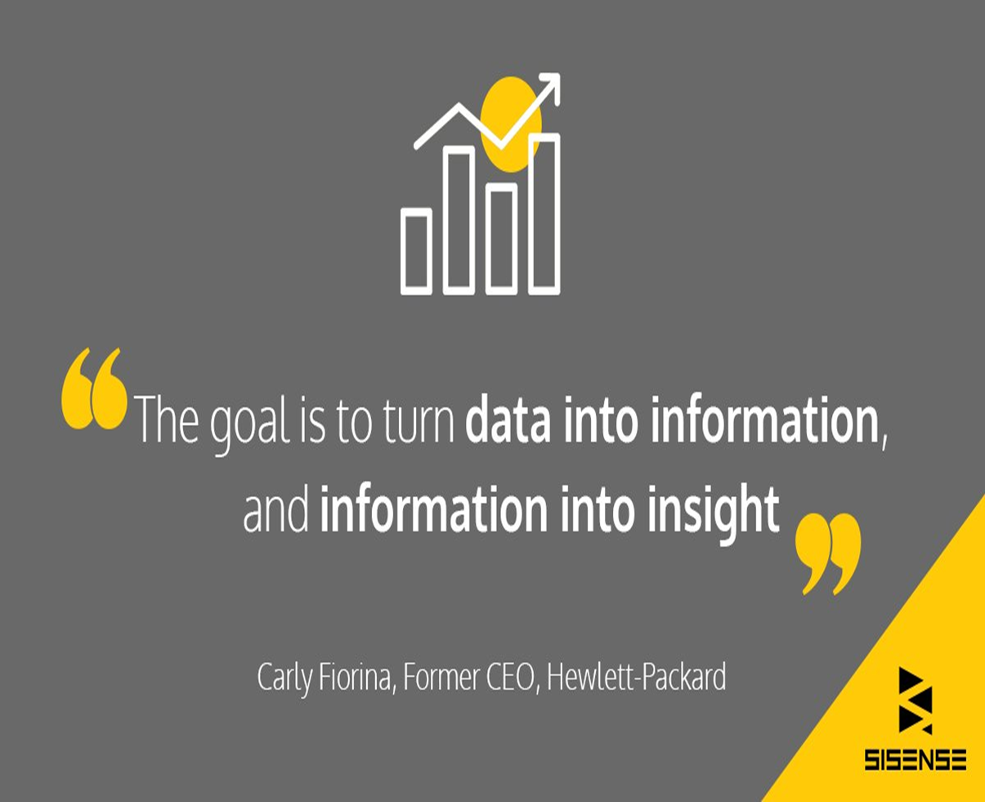
Conclusion
Through the analysis of Google Play Store datasets using Tableau for visual exploration, valuable insights can be derived to guide app development businesses. These insights help in creating successful apps and effectively capturing the Android market.
By understanding user preferences, app attributes, and customer sentiments, developers can make informed decisions to optimize app engagement and drive success in the competitive app market.

Slide 25
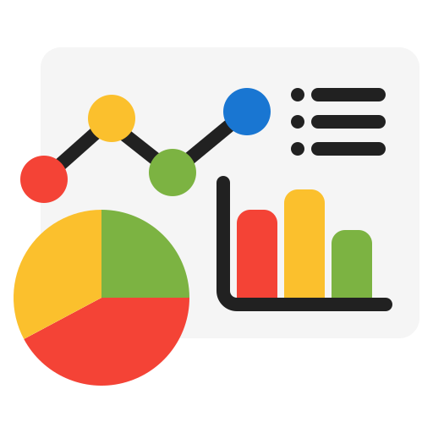

Thank You !

